Slide 1
Project Overview
Effective key generation for multimedia and web application.s

Slide 2
Abstract
Secure multicast represents the core component of many web and multimedia applications such as pay-TV, teleconferencing, real-time distribution of stock market price and etc. The main challenges for secure multicast is scalability, efficiency and authenticity. In this project, we propose a scalable, efficient, authenticated group key agreement scheme for large and dynamic multicast systems. The proposed key agreement scheme is identity-based which uses the bilinear map over the elliptic curves. Compared with the previously published schemes, our scheme provides group member authenticity without imposing extra mechanism. Furthermore, we give a scalability solution based on the subgroups, which has advantages over the existing schemes. Security analysis shows that our scheme satisfies both forward secrecy and backward secrecy.

Slide 3
Introduction
Many types of group applications, such as pay per view distribution of digital media, teleconferencing, software updates and real-time delivery of stock market information can benefit from IP multicast [13, 14, and 15], which greatly reduced the server overhead and bandwidth usage by enabling source to send a single copy of message to multiple recipients. One of the main challenges for secure multicast is access control for making sure that only legitimate members of multicast group have access to the group communication. In the passed two or three decades, cryptography as become the well-established means to solve the security problems in networking. However, there are still a lot of difficulties for directly deploying cryptography algorithms into multicasting environment as what has been done for unicasting environment. The commonly used technique to secure multicast communication is to maintain a group key that is known to all users in the multicast group, but is unknown to any one outside the group [8, 16, 20, 21, 23, 29, 31, 32, 33, and 34]. Efficiently managing the group key is a difficult problem for large dynamic groups. Each time a member is added to or evicted from the communication group, the group key must be refreshed. The members in the group must be able to compute the new group key efficiently, at the same time forward and backward secrecy must be guaranteed. Because the group re-keying is very consumptive and frequently performed due to the nature of multicast communication, the way to update it in a scalable and secure fashion is required.

Slide 4
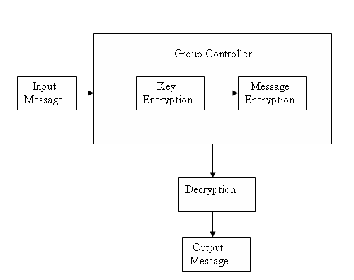
Data Flow Diagram

Slide 5
Overview of a Single Multicast Groups
Group controller
Local controller
Users
U1
U2
U3
U4

Slide 6
Module Description
User Interface
In this module we design the user interface to send and receive messages.
Key encryption
The key is generated and encrypted in this module. The encryption is done to increase the security to avoid intruders from hacking the key.
Message encryption
In addition to key encryption, the message is also encrypted in the group controller. This encryption avoids intruders misusing the message. This module increases the security of the message.
Message decryption
Encrypted message is decrypted before receiving at the receiver end. This decryption enables the authorized user to receive the original message.

Slide 7
Existing System
  When a group member join or leave only affect subgroup only while the other subgroup will not be affected. It has the drawback of affecting data path. This occurs in the sense that there is a need for translating the data that goes from one subgroup, and thereby one key, to another. This becomes even more problematic when it takes into account that the GSI has to manage the subgroup and perform the translation needed. The GSI may thus becomes the bottleneck.

Slide 8
Proposed System
  The advantages over the existing system are, we use an identity tree instead of key tree in our scheme. Each node in the identity tree is associated with an identity. The leaf node’s identity is corresponding to the user’s identity and the intermediate node’s identity is generated by its children’s identity. Hence, in an identity tree, an intermediate node represents a set users in the sub tree rooted at this node.
  In our scheme, even though a subgroup controller
  fails, it does not affect its subgroup. Because every user in the subgroup can act as the subgroup group controller.

Slide 9
Proposed System
The keys used in each subgroup can be generated by a group of key generation centers (KGCs) in parallel. All the members in the same subgroup can compute the same subgroup key though the keys for them are generated by different KGCs. This is a desirable feature especially for the large-scale network systems, because it minimizes the the problem of concentrating the workload on a single entity.

Slide 10
Software Requirement Specification
Hardware Interface
Hard disk : 40 GB
RAM : 512 MB
Processor Speed : 3.00GHz
Processor : Pentium IV Processor
Software Interface
JDK 1.5
Java Swing
SQL Server

Slide 11
Conclusion
The Proposed system is an efficient, authenticated, scalable key agreement for large and dynamic multicast systems, which is based on the bilinear map. Compared with the Existing system, we use an identity tree to achieve the authentication of the group member. Further, it solve the scalability problem in multicast communications. Since a large group is divided into many small groups. Each subgroup is treated almost like a separate multicast group with its own subgroup key. All the keys used in each subgroup can be generated by a group of KGC’s in parallel. The intuitively surprising aspect of this scheme is that, even the subgroup controller aborts, it does not affect the users in this subgroup. Because every user in the subgroup can act as a subgroup controller. This is a significant feature especially for the mobile and ad hoc networks. From the security analysis we can see that our scheme satisfies both forward and backward secrecy.

